Slide 1
MICROOPERATIONS
UNIT 3

Slide 2
Microoperation???
Every complex instruction on a computer is a composition of smaller instructions that can’t be subdivided into smaller instructions. The smallest unit of instruction is a micro-operation performed by the CPU.

Slide 3
MICRO-OPERATION
In computer central processing units, micro-operations (also known as micro-ops) are the functional or atomic, operations of a processor.
They generally perform operations on data stored in one or more registers. They transfer data between registers or between external buses of the CPU, also performs arithmetic and logical operations on registers.
In executing a program, operation of a computer consists of a sequence of instruction cycles, with one machine instruction per cycle. Each instruction cycle is made up of a number of smaller units – Fetch, Indirect, Execute and Interrupt cycles.
Each of these cycles involves series of steps, each of which involves the processor registers. These steps are referred as micro-operations.

Slide 4
A digital computer system exhibits an interconnection of digital modules such as registers, decoders, arithmetic elements, and Control logic.
These digital modules are interconnected with some common data and control paths to form a complete digital system.
Moreover, digital modules are best defined by the registers and the operations that are performed on the data stored in them.
The operations performed on the data stored in registers are called Micro-operations.

Slide 5
A computer works on instructions. Our systems consist of machine instructions to perform some operations like add, subtract, multiply, divide etc. To perform these operations, the system stores the data in registers. Now, to operate this data, the CPU has micro-operations. A micro-operation is a simple operation performed on the data stored in one or more registers. They transfer the data between registers. There are four types of micro-operations:-
Arithmetic micro-operations
Logic micro-operations
Shift micro-operations

Slide 6
ARITHMETIC MICROOPERATION
Arithmetic microoperation is such type of microoperation which performs arithmetic operation on numeric data stored in the registers.
ADDITION
SUBTRACTION
INCREMENT
DECREMENT
SHIFT
TYPES OF MICRO-OPERATIOINS

Slide 7
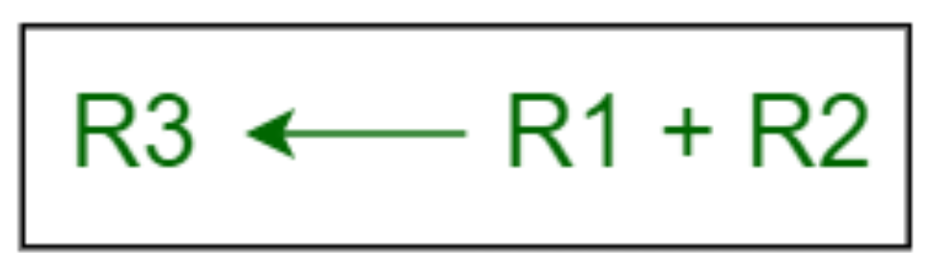
Addition:
In addition micro-operation, the value in register R1 is added to the value in the register R2 and then the sum is transferred into register R3.

Slide 8
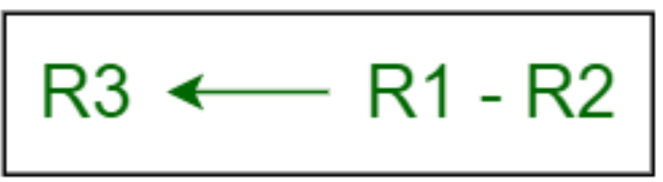
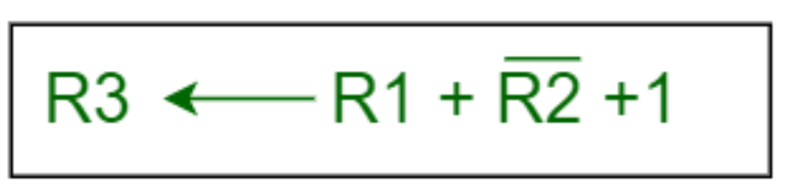
Subtraction:
In subtraction micro-operation, the contents of register R2 are subtracted from contents of the register R1, and then the result is transferred into R3.
• There is another way of doing the subtraction. In this, 2’s complement of R2 is added to R1, which is equivalent to R1 – R2, and then the result is transferred into register R3.

Slide 9
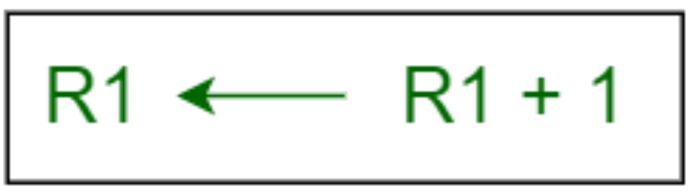
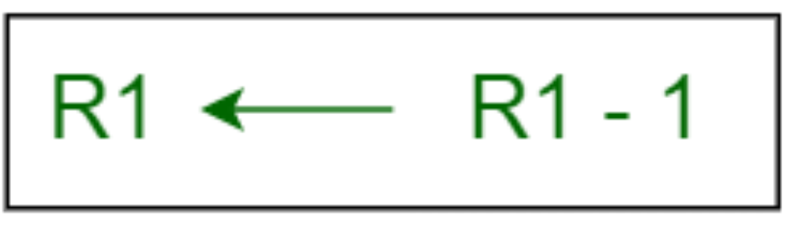
Increment:
In Increment micro-operation, the value inside the R1 register is increased by 1.
Decrement:
In Decrement micro-operation, the value inside the R1 register is decreased by 1.

Slide 10
Shift: This micro-operation shifts the bits in a register to the left or right, depending on the direction specified.

Slide 11
Logic micro-operations
Logic Microoperation specify binary operation for string of bits stored in registers.
These operation considered each bits of the registers separately and treat them as variables(binary Variables).

Slide 12
Logical Shift
A logical shift moves bits to the left or right, filling the vacated bit positions with zeros. This type of shift is typically used for unsigned binary numbers.
Logical Left Shift
In a logical left shift, each bit is moved one position to the left, and the least significant bit (LSB) is filled with zero. The most significant bit (MSB) is discarded. This operation effectively multiplies the number by 2 for each shift position.
# Example of logical left shift
x = 5 # binary: 00000101
x = x << 1 # binary: 00001010, decimal: 10

Slide 13
Logical Right Shift
In a logical right shift, each bit is moved one position to the right, and the MSB is filled with zero. The LSB is discarded. This operation effectively divides the number by 2 for each shift position.
# Example of logical right shift
x = 5 # binary: 00000101
x = x >> 1 # binary: 00000010, decimal: 2

Slide 14
Arithmetic Shift
An arithmetic shift is used for signed binary numbers and preserves the sign of the number. The MSB, which represents the sign bit, is treated differently in arithmetic shifts.
Arithmetic Left Shift
An arithmetic left shift is similar to a logical left shift. Each bit is moved one position to the left, and the LSB is filled with zero. The MSB is discarded. This operation also multiplies the number by 2 for each shift position.
# Example of arithmetic left shift
x = -5 # binary: 11111011 (two's complement representation)
x = x << 1 # binary: 11110110, decimal: -10

Slide 15
Arithmetic Right Shift
In an arithmetic right shift, each bit is moved one position to the right, and the MSB is filled with the value of the previous MSB (the sign bit). This operation effectively divides the number by 2 for each shift position while preserving the sign.
# Example of arithmetic right shift
x = -5 # binary: 11111011 (two's complement representation)
x = x >> 1 # binary: 11111101, decimal: -3

Slide 16
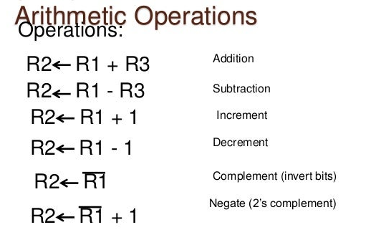
RTL Example:

Slide 17
Arithmetic microoperation
Binary Adder
Binary Adder Subtracter
Binary Incrementer
Arithmetic circuit

Slide 18
Binary Adder:
The registers play an important role in performing the micro-operations. The registers hold the digital component and the data which performs the arithmetic operation. The Binary Adder is a logical circuit which is used to perform the addition operation of two binary number of any length.
The Binary Adder is formed with the help of the Full-Adder circuit. The Full-Adders are connected in series, and the output carry of the first Adder will be treated as the input carry of the next Full-Adder.

Slide 19
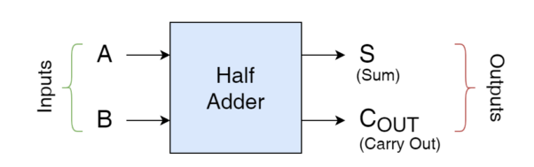
Half Adder
It is a combinational logic circuit that performs the addition of two binary bits or digits which, consequently, produces SUM and CARRY binary digits (bits).
In Half Adder, the CARRY output generated can be ignored as there is no input to consider this CARRY generated from the preceding Half Adder.
A careful observation of results produced on SUM output against different input combinations, yields that the outputs are similar to the one produced by an Exclusive-OR (XOR) gate.
This can be illustrated if inputs of XOR Gate are labeled as “A” & “B” and single output as “S” to represent SUM. The following diagram of XOR Gate along with its Truth Table resembles the Half Adder output when CARRY output is ignored.

Slide 20
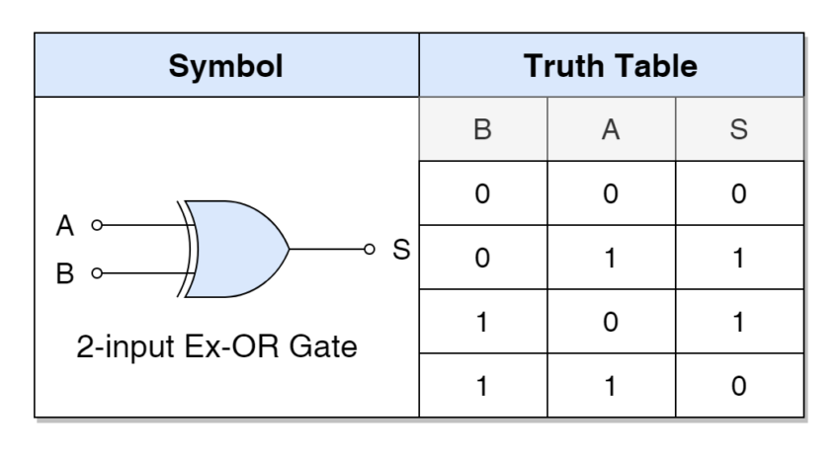

Slide 21
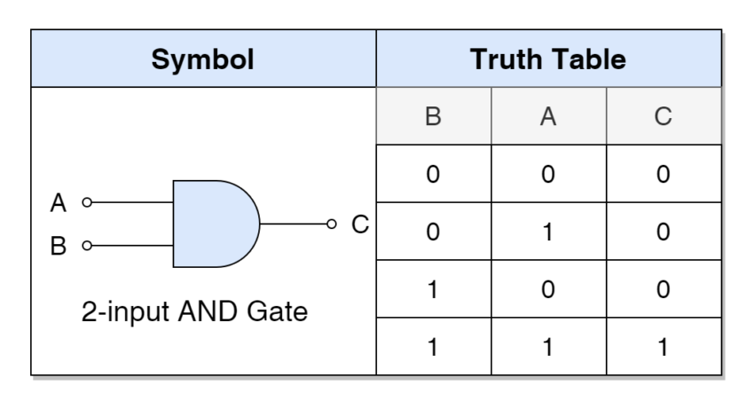
It is well-known from the above table that the “S” or “SUM” bit is produced (“1”) when there is an exclusive or different combination otherwise it is set to “0”.
This means that the “SUM” output of a Half Adder can be generated using an Exclusive-OR (Gate). Whereas, the CARRY output is produced only when both inputs (A & B) are “HIGH” or “1” otherwise it is set to “LOW” or “0”.
This desired function is similar to the function of an AND Gate which is given below in the form of a Truth Table along with its symbol.

Slide 22
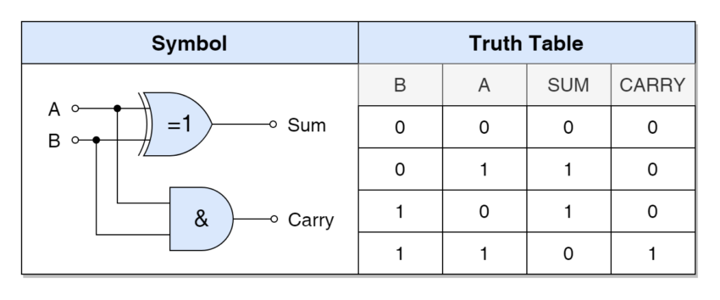
Hence, a Half Adder can be constructed using XOR and AND gates
The logic diagram of Half Adder with its Truth Table is shown below:
The SUM bit is an Exclusive-OR function which is given below:
SUM = A XOR B = A⊕B
Whereas, the CARRY bit is an AND function:
CARRY = A AND B = A.B

Slide 23
The Half Adder does not consider the input CARRY bit in its SUM function and, as such, cannot be used to cascade multiple Half Adders to perform SUM of binary numbers having more than one digit as the CARRY bit results from “1+1” cannot be passed to next higher bit addition. This can be regarded as one of the biggest disadvantages of a Half-Adder circuit.
In order to overcome this disadvantage or perform the addition of more than one-digit binary numbers, a Full Adder circuit is utilized.

Slide 24
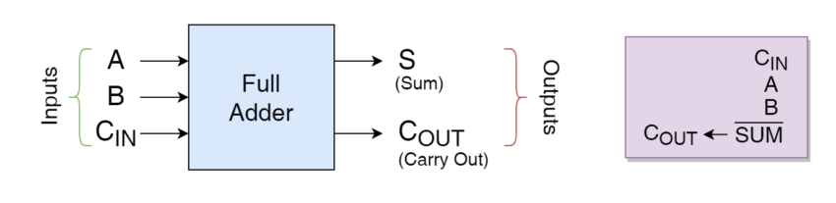
FULL ADDER
A Full Adder is another combinational logic circuit that performs an arithmetic operation of additions similar to the one performed by a Half Adder but, with the difference that a Full Adder considers CARRY at its input for performing the addition function.
So, in addition to “A” & “B”, there is a “C_{IN}” input that takes into account the carry-bit generated from the preceding sum operation. A Full Adder circuit is illustrated by the following diagram.

Slide 25
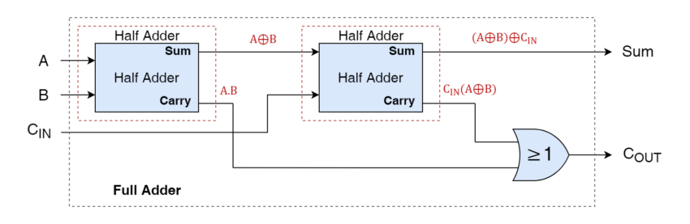
A Full Adder can be constructed using two Half Adder circuits where the second Half Adder sums the Carry input (C_{IN}) and Sum (SUM) generated by the first Half Adder, as shown in the following logical diagram.

Slide 26
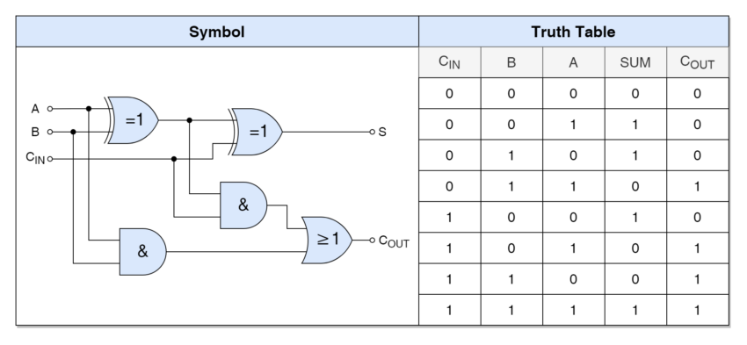
Full Adder Circuit with Truth Table
For SUM bit:
SUM=(A XOR B) XOR Cin = (A⊕B)⊕Cin
For CARRY-OUT:
CARRY-OUT = A AND B OR Cin(A XOR B) = A.B + Cin(A⊕B)

Slide 27
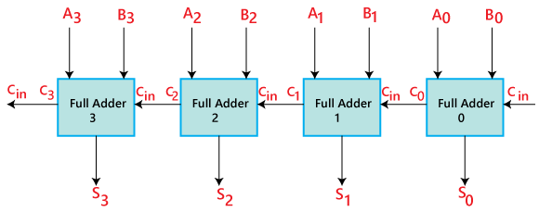
N BIT BINARY ADDER
The 'A' and 'B' are the augend, and addend bits are defined by the subscript numbers. The subscripts start from right to left, and the lower-order bit is defined by subscript '0'.
The C0, C1, C2, and C3 are the carry inputs which are connected together as a chain using Full Adder. The C4 is the carry output produced by the last Full-Adder.
The C_{out} of the first Adder is connected as the C_{in} of the next Full-Adder.
The S0, S1, S2, and S3 are the sum outputs that produce the sum of augend and addend bits.
The inputs for the input variable 'A' and 'B' are fetched from different source registers. For example, the bit for the input variable 'A' comes from register 'R1', and a bit for the input variable 'B' comes from register 'R2'.

Slide 28
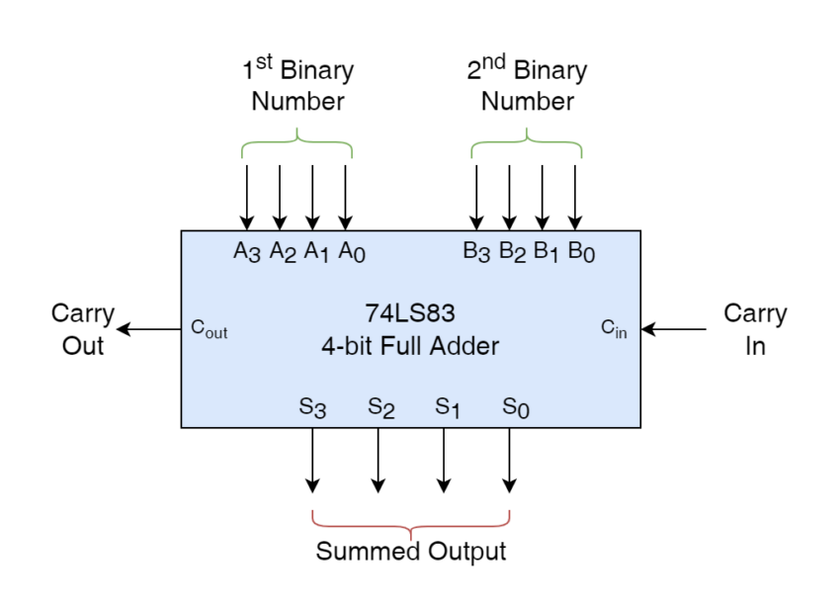

Slide 29
Binary Adder Subtraction
The Subtraction micro-operation can be done easily by taking the 2's compliment of addend bits and adding it to the augend bits.
The Arithmetic micro-operations like addition and subtraction can be combined into one common circuit by including an exclusive-OR gate with each full adder.

Slide 30
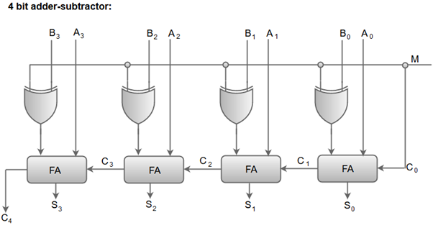
When the mode input (M) is at a low logic, i.e. '0', the circuit act as an adder and when the mode input is at a high logic, i.e. '1', the circuit act as a subtractor.
The exclusive-OR gate connected in series receives input M and one of the inputs B.
When M is at a low logic, we have B⊕ 0 = B. The full-adders receive the value of B, the input carry is 0, and the circuit performs A plus B.
When M is at a high logic, we have B⊕ 1 = B' and C0 = 1. The B inputs are complemented, and a 1 is added through the input carry. The circuit performs the operation A plus the 2's complement of B.

Slide 31
When the mode input (M) is at a low logic, i.e. '0', the circuit act as an adder and when the mode input is at a high logic, i.e. '1', the circuit act as a subtractor.
The exclusive-OR gate connected in series receives input M and one of the inputs B.
When M is at a low logic, we have B⊕ 0 = B. The full-adders receive the value of B, the input carry is 0, and the circuit performs A plus B.
When M is at a high logic, we have B⊕ 1 = B' and C0 = 1. The B inputs are complemented, and a 1 is added through the input carry. The circuit performs the operation A plus the 2's complement of B.

Slide 32
Binary incrementer
The increment micro-operation inserts one to a number in a register. For example, if a 4-bit register has a binary value 0110, it will go to 0111 after it is incremented. The increment micro-operation is performed by a 4-bit combinational circuit incrementer.
This micro-operation is simply performed with a binary counter. Each time the count allowed is active, the clock pulse transition increments the content of the register by one.
We can simply say that it increases the value stored in the register by 1.
For any n-bit binary incrementer ,‘n’ refers to the storage capacity of the register which needs to be incremented by 1. So we require ‘n’ number of half adders . Thus, in case of 4 bit binary incrementer we require 4 half adders.

Slide 33
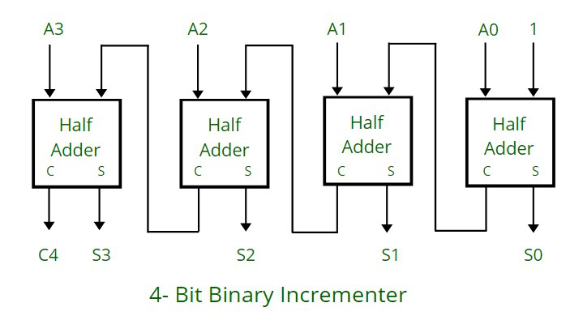
The half adders are connected one after the other , as it has 2 inputs and 2 outputs , so for the LSB ( least significant bit) half adder or the right most half adder is given 1 as direct input( first input) and A0 which is the first bit of the register (second input) , so we get the two output : sum (S0) and carry (C).
The carry(C) from previous half adder is propagated to the next half adder, so the carry output of the previous half adder becomes the input of the next higher order half adder.
So considering the case for 4 half adders the circuit gets in total 4 bits (A0, A1, A2, A3), 1 is added and we get an incremented output.

Slide 34
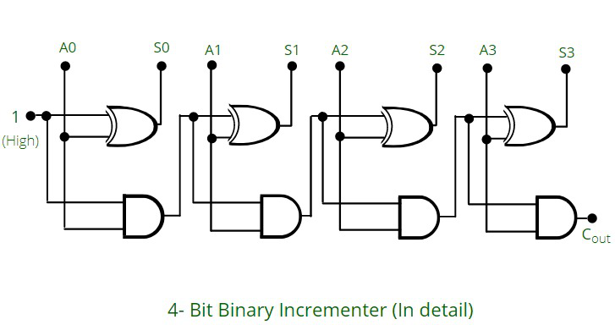
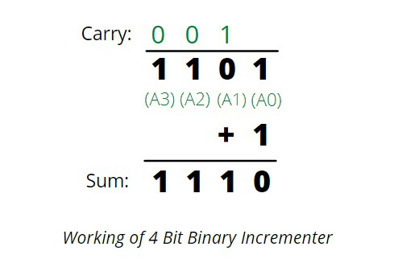

Slide 35
1. Input: 1010 ----> After using 4 bit binary incrementer ----> Output: 1011
1 0 1 0 (Comparing from the circuit 1 0 1 0 is A3, A2, A1, A0 respectively)
+ 1 (1 is added as seen in the diagram also, in the first half adder, 1 is taken as input)
_________
1 0 1 1 ( 1 0 1 1 , in the diagram are S3, S2, S1, S0 respectively)
_________

Slide 36
Truth Table:
Hence, the different operations for the inputs A and B are –
A + B (adder)
A + B + 1 (add with carry)
A + B’ (subtract with borrow)
A – B (subtracter)
A (Transfer A)
A + 1 (incrementer)
A – 1 (decrementer)
S₀ | S₁ | C₀ | MUX Output | Full Adder Output
0 | 0 | 0 | B | A + B
0 | 0 | 1 | B | A + B + 1
0 | 1 | 0 | B’ | A + B’
0 | 1 | 1 | B’ | A + B’ + 1 = A – B
1 | 0 | 0 | 0 | A
1 | 0 | 1 | 0 | A + 1
1 | 1 | 0 | 1 | A – 1
1 | 1 | 1 | 1 | A – 1 + 1 = A

Slide 37
Logic microoperations
Logic micro-operations are used on the bits of data stored in registers. These micro-operations treat each bit independently and create binary variables from them.
Logic micro-operations are bit-wise operations, i.e., they work on the individual bits of data. They are useful for bit manipulations on binary data and for making logical decisions based on the bit value.
Useful for bit manipulations on binary data and for making logical decisions based on the bit value. There are, in principle, 16 different logic functions that can be defined over two binary input variables. However, most systems only implement four of these
– AND (^), OR (۷), XOR (⊕), Complement/NOT
The others can be created from combination of these four functions.

Slide 38

Logic microoperations specify binary operations for strings of bits stored in registers.
These operations consider each bit of the register separately and treat them as binary variables.
For example, the exclusive-OR microoperation with the contents of two registers R 1 and R2 is symbolized by the statement P: R1 ← R1 ⊕ R2
It specifies a logic microoperation to be executed on the individual bits of the registers provided that the control variable P = 1. As a numerical example, assume that each register has four bits. Let the content of R1 be 1010 and the content of R2 be 1100.
The exclusive-OR microoperation stated above symbolizes the following logic computation:
The content of R1, after the execution of the microoperation, is equal to the bit-by-bit exclusive-OR operation on pairs of bits in R2 and previous values of R1. The logic microoperations are seldom used in scientific computations, but they are very useful for bit manipulation of binary data and for making logical decisions.

Slide 39
Special symbols are adopted for the logic microoperations OR, AND, and complement, to distinguish them from the corresponding symbols used to express Boolean functions.
The symbol V will be used to denote an OR microoperation and the symbol ∧ to denote an AND microoperation. The complement microoperation is the same as the 1's complement and uses a bar on top of the symbol that denotes the register name.
By using different symbols, it will be possible to differentiate between a logic microoperation and a control (or Boolean) function.
**Logic micro operations are basic operations performed on binary data at the hardware level in a computer processor. These operations are used to manipulate and process digital information within the processor. They are executed by the arithmetic and logic unit (ALU) of the processor and are a fundamental building block of digital circuits.

Slide 40
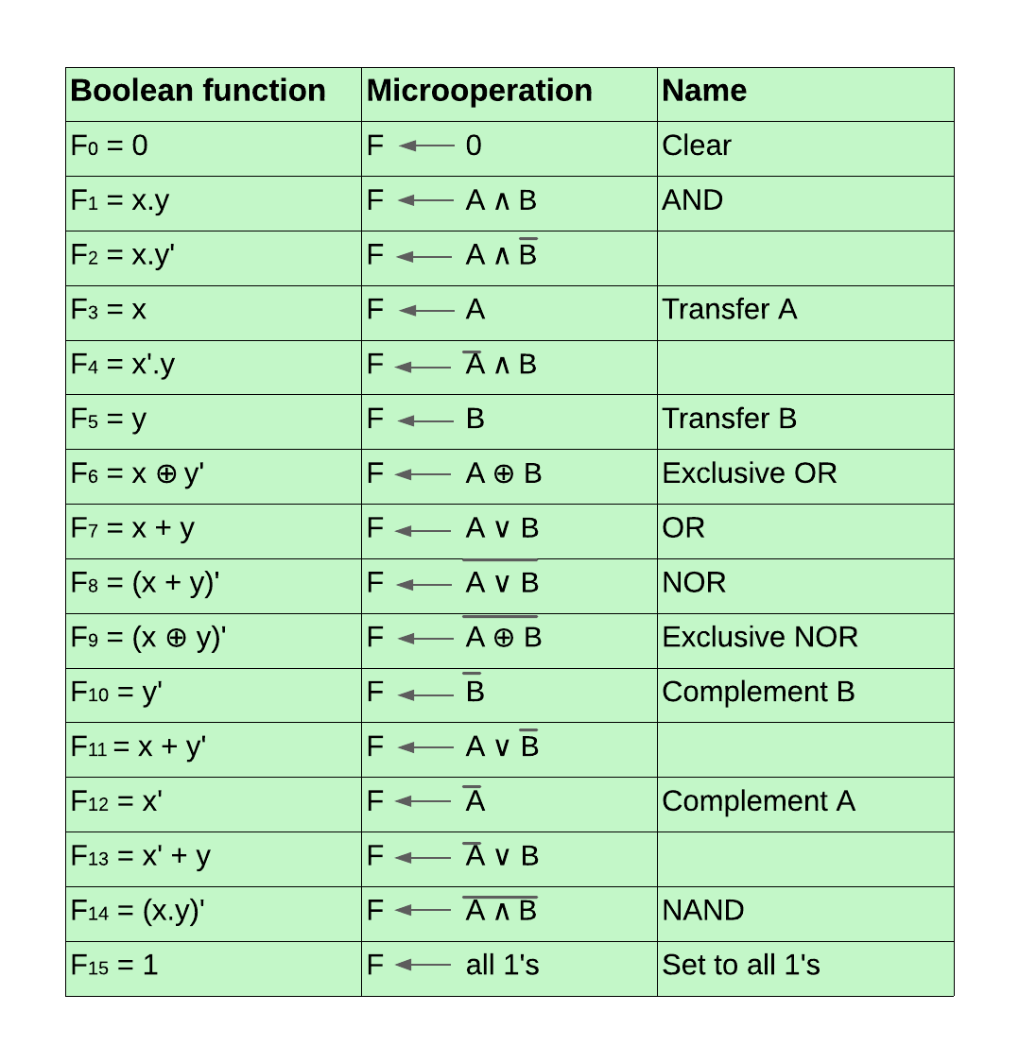

Slide 41
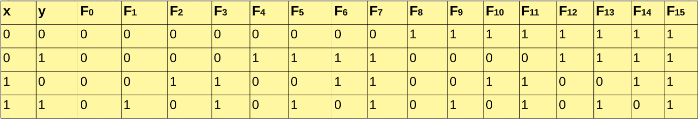

Slide 42
Applications of logic microoperations
digital circuits,
arithmetic logic units,
MUX (multipliers),
DEMUX (demultiplexers),
data encryption,
hashing,
memory addressing,
decoding,
bit masking,
communication systems,
digital system design,
digital signal processing.

Slide 43
Shift microoperations
Shift microoperations are fundamental operations used in digital circuits and computer architectures to manipulate data by serially transferring it within a register or between registers. They essentially involve moving the bits of data one position to the left or right.
Logical Shift, Circular shift, Arithmetic Shift

Slide 44
1. Logical Shift:
This type of shift simply moves the data bits without affecting their values. Think of it like sliding the beads on an abacus to the left or right. The empty positions at the end are filled with zeros.
It transfers the 0 zero through the serial input. We use the symbols ‘<<‘ for the logical left shift and ‘>>‘ for the logical right shift.
The symbol "shl" can be used for logical shift left and "shr" can be used for logical shift right.
R1 ←R1 shl R1
R2 ←R1 shr R2

Slide 45
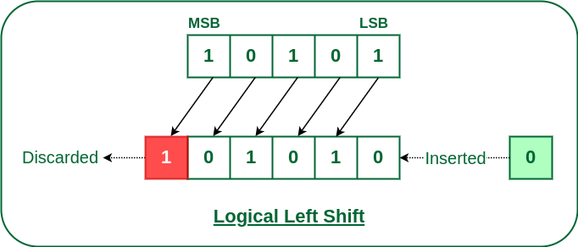
Logical Left Shift
In this shift, one position moves each bit to the left one by one. The Empty least significant bit (LSB) is filled with zero (i.e, the serial input), and the most significant bit (MSB) is rejected.
The left shift operator is denoted by the double left arrow key (<<). The general syntax for the left shift is shift-expression << k.

Slide 46
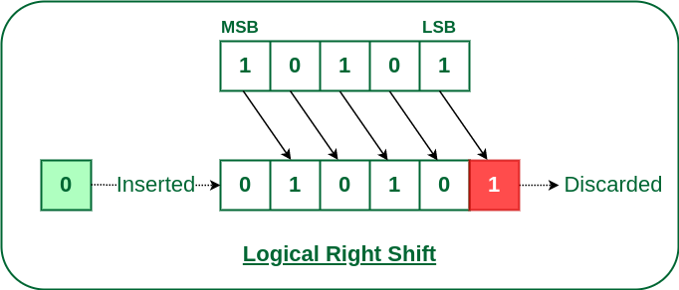
Logical Right Shift
In this shift, each bit moves to the right one by one and the least significant bit(LSB) is rejected and the empty MSB is filled with zero.
The right shift operator is denoted by the double right arrow key (>>). The general syntax for the right shift is “shift-expression >> k”.

Slide 47
Arithmetic Shift:
The arithmetic shift micro-operation moves the signed binary number either to the left or to the right position.
This type of shift is particularly useful for signed binary numbers. When shifting left, the sign bit (the leftmost bit) is kept the same, and the number is effectively multiplied by 2. Conversely, when shifting right, the number is divided by 2, and the sign bit remains unchanged.
Arithmetic Left Shift
Arithmetic Right Shift

Slide 48
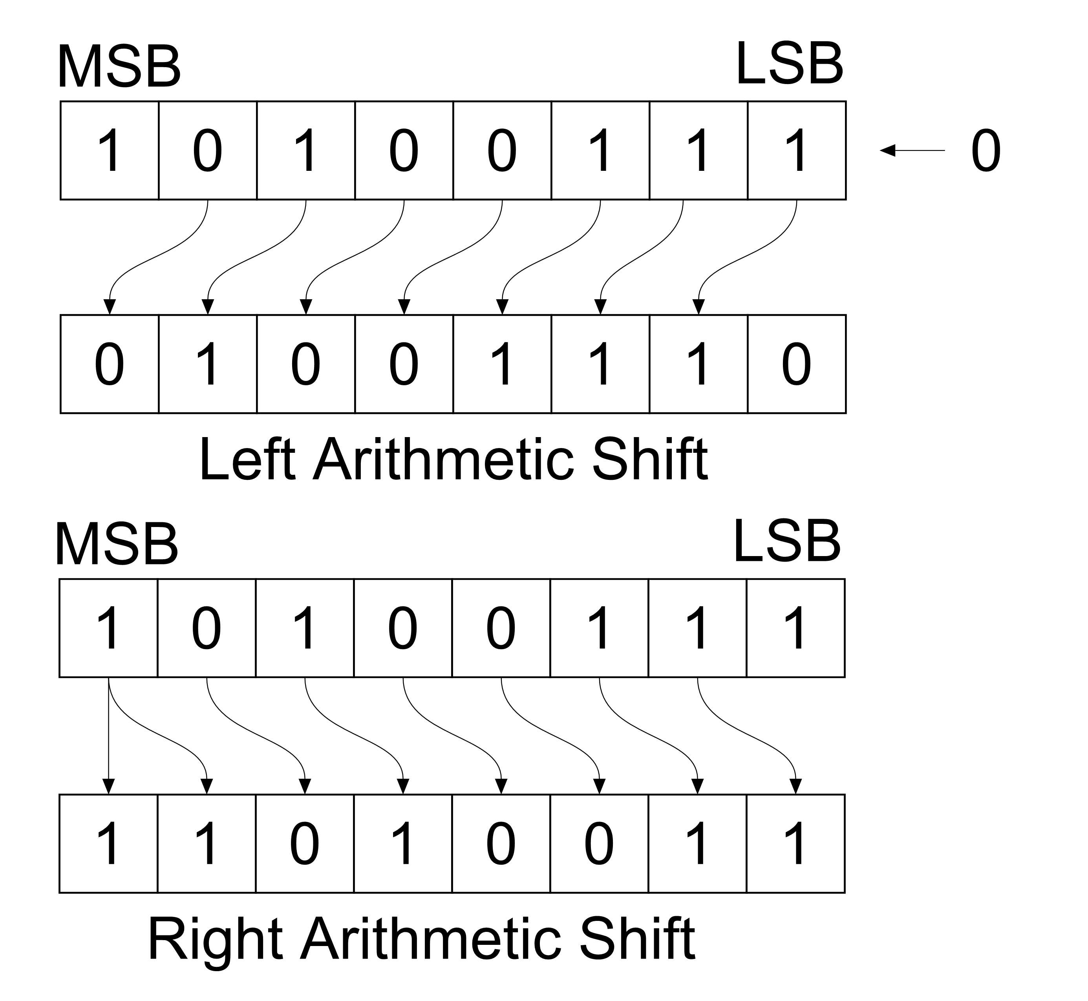

Slide 49
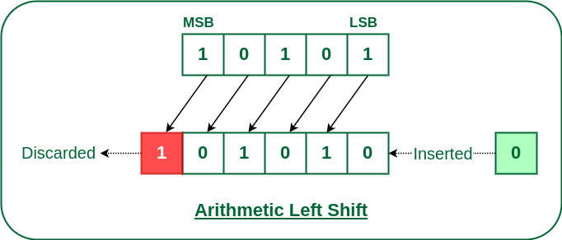
Arithmetic Left Shift:
In this shift, each bit is moved to the left one by one. The empty least significant bit (LSB) is filled with zero and the most significant bit (MSB) is rejected. Same as the Left Logical Shift.
For example, R1 -> ashl R1.
This command means the 8 bits present in the R1 register will be arithmetic shifted left, and the result will be stored in register R1

Slide 50
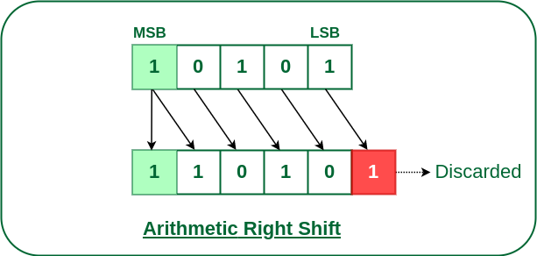
Arithmetic Right Shift:
In this shift, each bit is moved to the right one by one and the least significant(LSB) bit is rejected and the empty most significant bit(MSB) is filled with the value of the previous MSB.
For example, R1 -> ashr R1.
This command means the 8 bits present in the R1 register will be arithmetic shifted right, and the result will be stored in register R1.

Slide 51
Circular Shift:
In this type of shift, the data bits are "rotated" within the register. The bits that fall off one end re-enter on the other end, creating a circular movement. This type of shift is useful for operations like finding the minimum or maximum value in a set of data.
The circular shift circulates the bits in the sequence of the register around both ends without any loss of information.
Circular Shift Left
Circular Shift Right

Slide 52
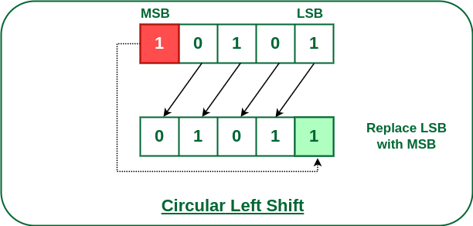
Circular Left Shift:
In this micro shift operation each bit in the register is shifted to the left one by one. After shifting, the LSB becomes empty, so the value of the MSB is filled in there.

Slide 53
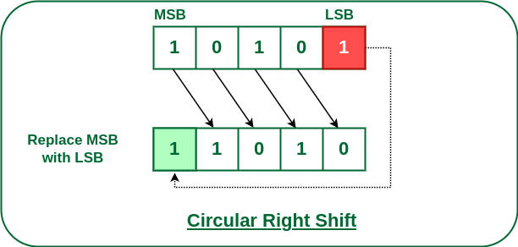
Circular Right Shift:
In this micro shift operation each bit in the register is shifted to the right one by one. After shifting, the MSB becomes empty, so the value of the LSB is filled in there.

Slide 54
Arithmetic Logic Shift Unit (ALSU) is a member of the Arithmetic Logic Unit (ALU) in a computer system. It is a digital circuit that performs logical, arithmetic, and shift operations.
Rather than having individual registers calculating the micro operations directly, the computer deploys a number of storage registers which is connected to a common operational unit known as an arithmetic logic unit or ALU.
To implement the micro operation, the contents of specified registers are allocated in the inputs of the common Arithmetic Logic Unit. The Arithmetic Logic Unit performs an operation that leads as a result and gets transferred to a destination register.
Arithmetic Logic Unit may be a combinatory circuit in order that the complete register transfer operation from the supply registers through the ALU and into the destination register is performed throughout one clock pulse amount.

Slide 55
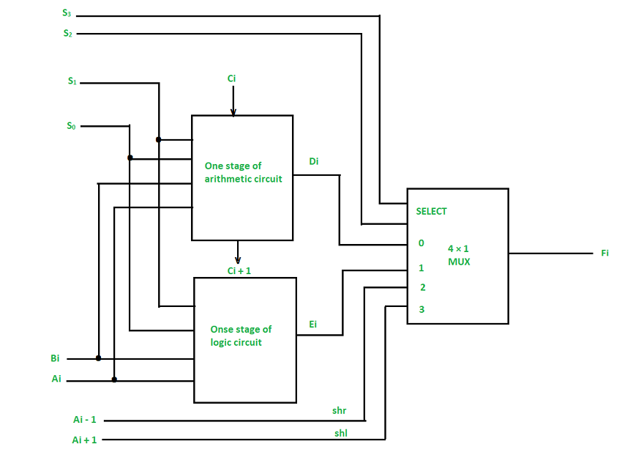
Block Diagram of ALSU

Slide 56
We can combine and make one ALU with common selection variables by adding arithmetic, logic, and shift circuits. We can see the, One stage of an arithmetic logic shift unit in the diagram above. Some particular micro operations are selected through the inputs S1 and S0.
4 x 1 multiplexer at the output chooses between associate arithmetic output between Ei and a logic output in Hi. The data in the multiplexer are selected through inputs S3 and S2 and the other two data inputs to the multiplexer obtain the inputs Ai – 1 for the shr operation and Ai + 1 for the shl operation.
Note: The output carry Ci + 1 of a specified arithmetic stage must be attached to the input carry Ci of the next stage in the sequence.
The circuit whose one stage is given in the below diagram provides 8 arithmetic operations, 4 logic operations, and 2 shift operations, and Each operation is selected by the 5 variables S3, S2, S1, S0, and Cin.
The below table shows the 14 operations perform by the Arithmetic Logic Unit:
The first 8 are arithmetic operations which are selected by S3 S2 = 00
The next 4 are logic operations which are selected by S3 S2 = 01
The last two are shift operations which are selected by S3 S2 = 10 & 11

Slide 57
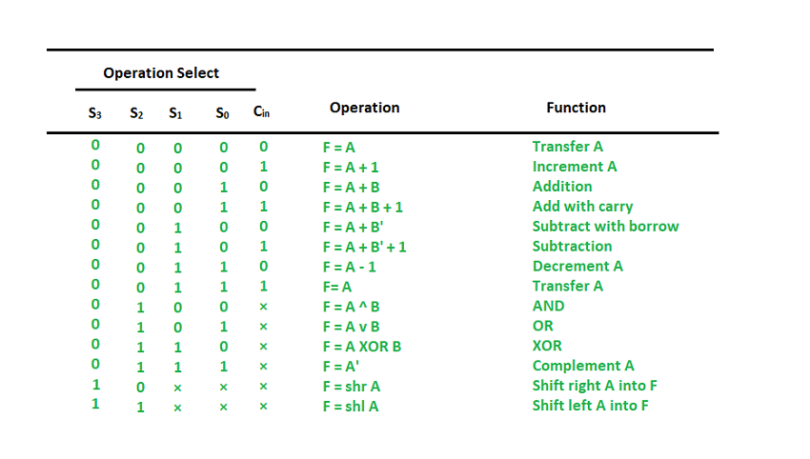

Slide 58
The End !!!!!

